Slide 1
UK Road Accident Severity Classification
STAT-652: Statistical Model and Prediction Final Project
Nattapat Juthaprachakul, 301350117
njuthapr@sfu.ca

Slide 2
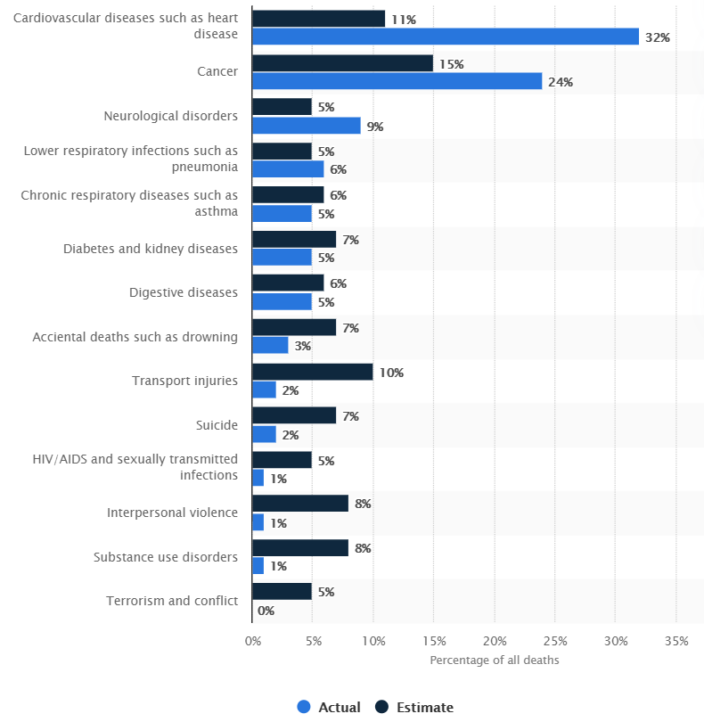
Motivation
Every day, almost 3,700 people killed globally
Ninth leading cause of death globally for all age groups
$1.8 trillion cost from 2015–2030
Source: https://www.cdc.gov/injury/features/global-road-safety/index.html
https://www.statista.com/statistics/1108748/cause-of-death-estimate-and-actual-worldwide/
Notes:
-Road accidents are major causes of deaths and injuries reported every year.
-According CDC, Every day, almost 3,700 people are killed globally in crashes
-It is estimated to be the ninth leading cause of death globally for all age groups. More people now die in crashes than from HIV/AIDS.
-it is estimated to cost world economy around 1.8 trillion dollar.
-However, it is often challenging to determine which conditions lead to these events, making it more difficult for us to address the severity of road accidents.
-We know that some characteristics of vehicles and the surroundings play a key role (engine capacity, condition of the road, etc.).
-However, many questions are still open. Which of these factors are the leading ones?
(- How much are the external factors to blame, compared to the driver skills?)

Slide 3
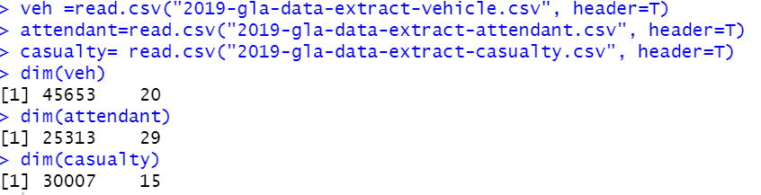
Data
Accident severity classification: Slight vs. Serious
UK Road Safety Data (2019): Slight, Serious, Fatal
3 Files: attendant, vehicle, and environment.
Original data: 45k+ rows and 55 columns
We use subset data: 10k+ rows
Source: https://data.gov.uk/dataset/cb7ae6f0-4be6-4935-9277-47e5ce24a11f/road-safety-data
Notes:
-In this project, I use 2019 UK Road Safety Data.
-the casualties in road accidents,
-the types of vehicles involved and the circumstances.
-However, I use a subset of 2019 dataset.
-since Full original dataset is highly unbalanced which have 3 classes: Fatal, Serious, Slight (of 0.5%/14%/84.5%)
-But Fatal is just 0.5 percent, so I drop that class and turn the problem into binary classification

Slide 4
Analysis Steps
Prediction
Data Preprocessing
Model Exploration
Parameter Tuning
Exploratory Data Analysis
Analysis
Notes:
Data Preprocessing + Exploratory Data Analysis
Model Exploration
Parameter Tuning
Prediction and Analysis

Slide 5
1.1 Data preprocessing
Dataset (n=10,032)
Class | Serious | Slight
Number of samples | 4,032 | 6,000
Percentage | 40.21% | 59.79%
Merge 3 files
Drop columns 90%+ same values
Drop columns with text data
Process datetime
Split train/test 90/10 proportionally
Etc.
90% of Dataset (n=9,029)
Class | Serious | Slight
Number of samples | 3,620 | 5,400
Percentage | 40.19% | 59.81%
10% of Dataset (n=1,003)
Class | Serious | Slight
Number of samples | 403 | 600
Percentage | 40.18% | 59.82%
Training Dataset
Test Dataset
Notes:
-merge 3 files of attendant, vehicle, and environment details based on ID
-drop features that has more than 90% percent of same values
-drop one of pair features that have correlation more than 95% percent
-drop column with text that need nlp technique to extract information
-process datetime column to hour, day, and month
-Then split dataset into train/test set as shown in the slide
-I try to split dataset into same proportion between 2 class as seen in 40/60% in all table
-the test dataset is kept into separate csv file for using in the prediction steps (last step)

Slide 6
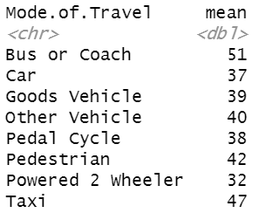
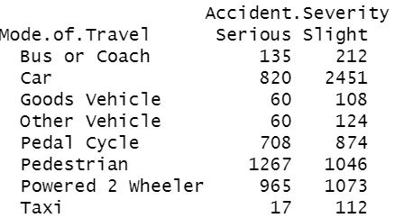
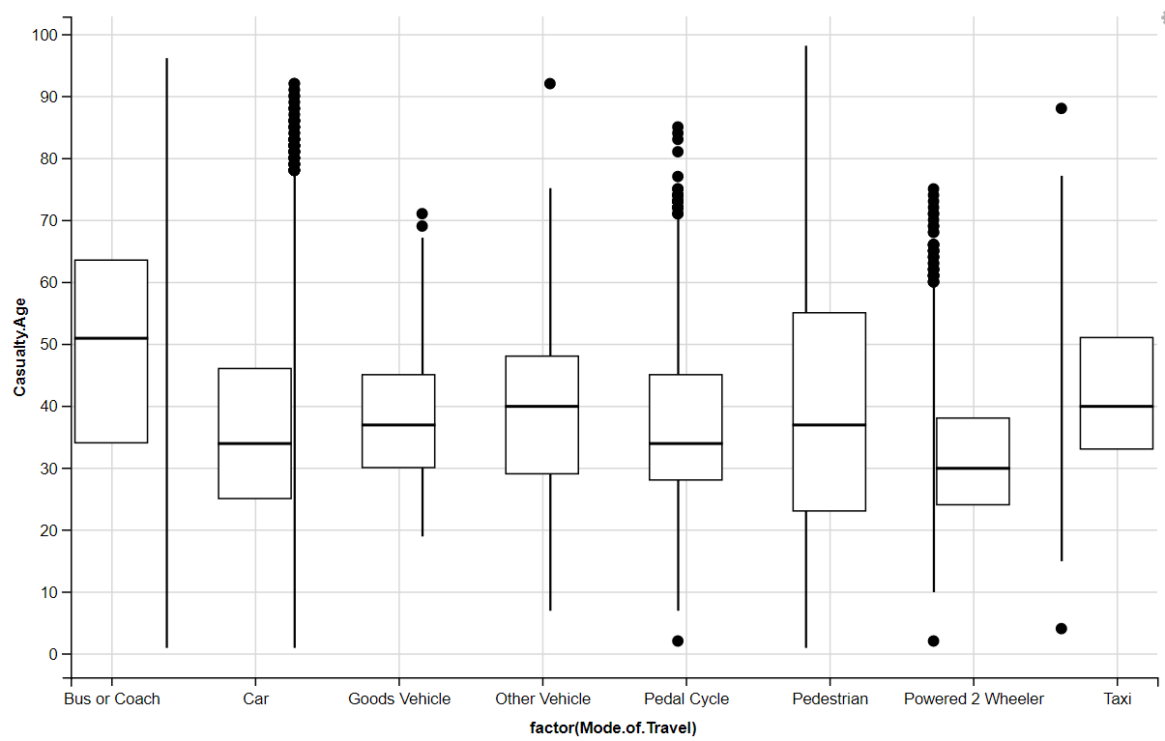
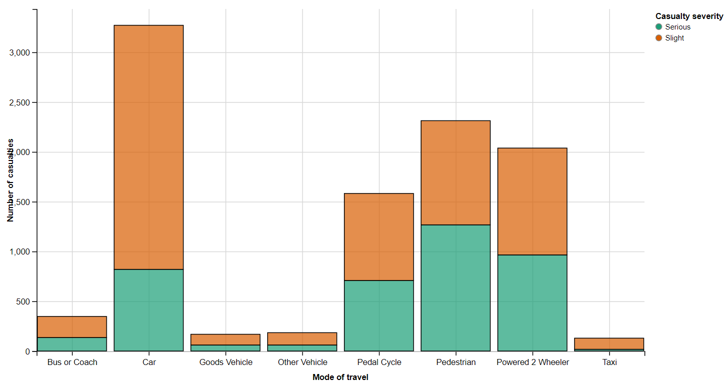
1.2 Exploratory Data Analysis
Notes:
-preprocess dataset by EDA such as seeing matrix of missing value
-collapse some values of feature to smaller class so we have smaller dummy encoding ex. 7 class to 3 class + 1 as other

Slide 7

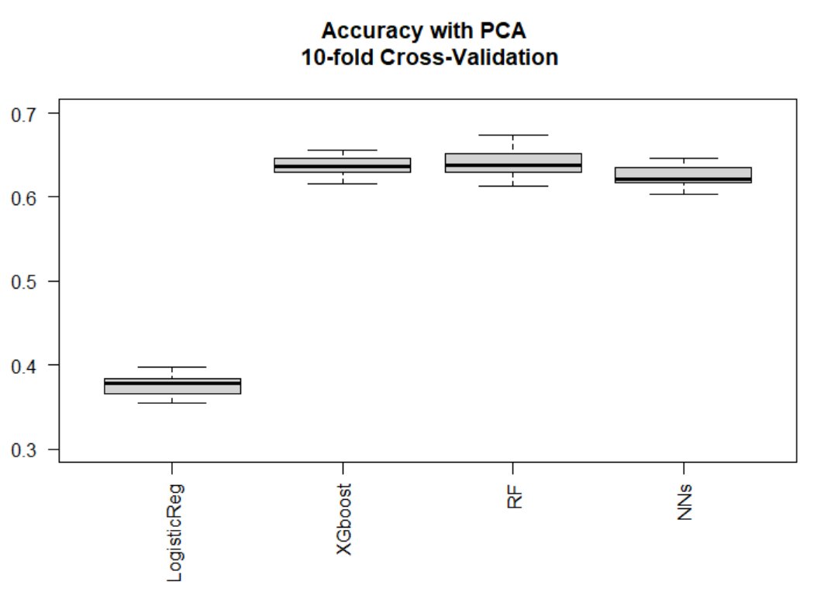
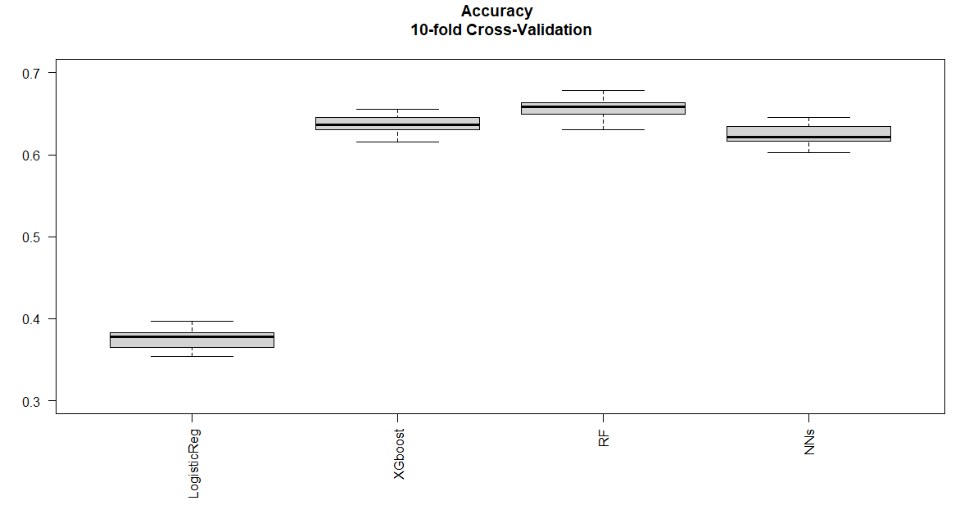
3. Model Exploration
10-fold cross validation
Notes:
-in model exploration, I pick 4 different models and use 10-fold cross validation
-the left one is I did PCA before doing modelling
- the metric I use to measure these models is accuracy which is 1-misclassification rate
-surprising result is that logistic regression has far lower accuracy and
RF beats XGboost.

Slide 8
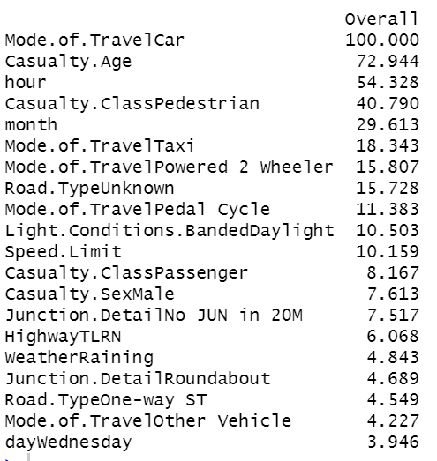
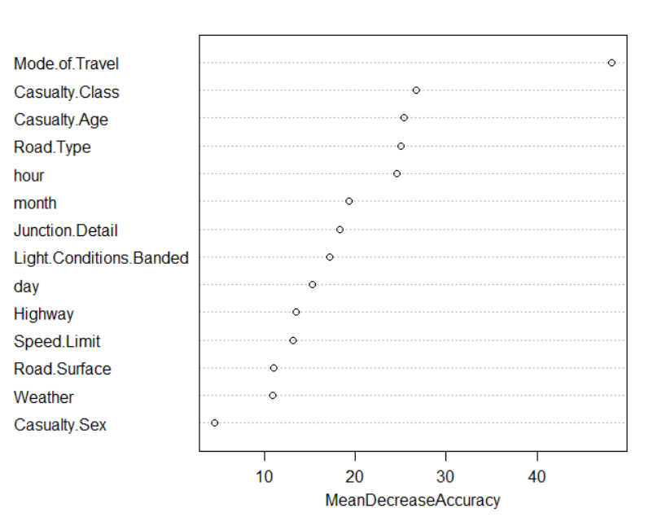
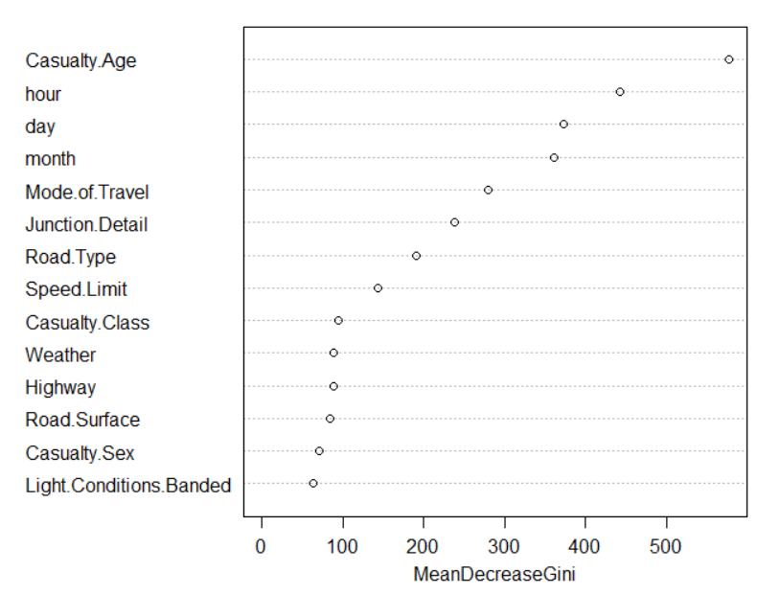
3. Model Exploration (cont.)
Feature scaling
Feature engineering
Variable importance
Notes:
-I also did feature scaling, feature engineering like datetime
-and this is some variable importance I get from random forest.
-surprising thing to see is hour, day, month, and age are very important.

Slide 9
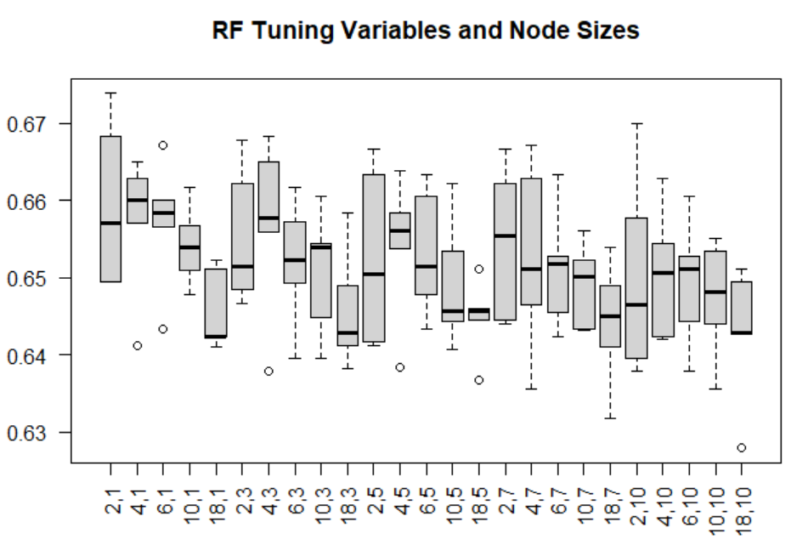
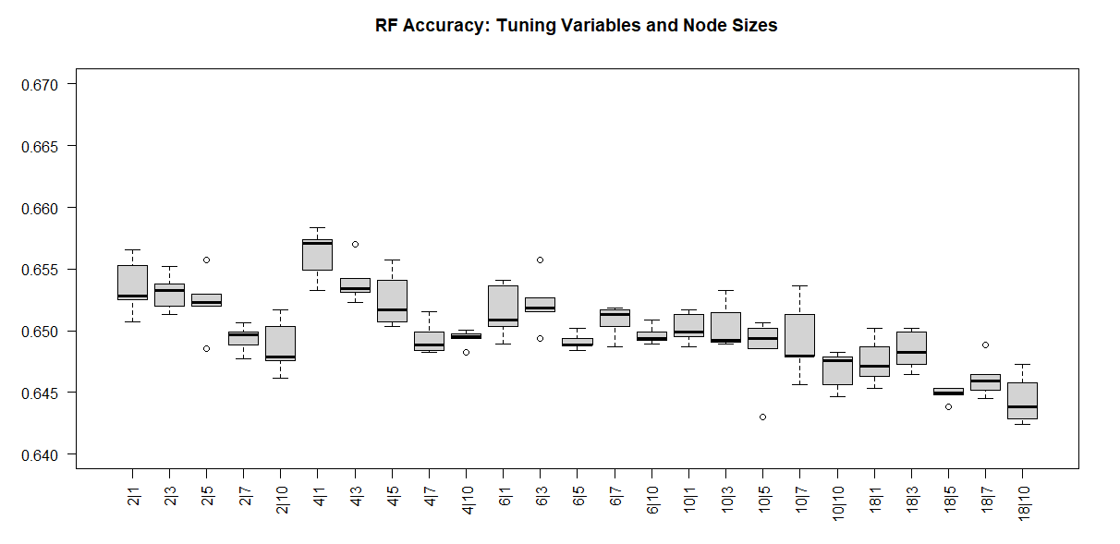
4. RF Parameter Tuning: 2 methods
mtry:(2,4,6,10,18), nodesize:(1,3,5,7,10) = 25 pairs
5-fold cv with 5 reps • OOB error with 5 reps
1 fold = 5 reps * 25 pairs = 125 runs = 25 average pairs
5 folds = 5 * 25 = 125 pairs
Notes:
-I tune the random forest.
-using that training data to try 2 methods:
1. using 5-fold cv with 5 repetition of each pair model in each fold
meaning that in each fold, I run every set of parameter 5 times to calculated its average accuracy
2. using OOB error with 5 repetition for each pair of hyperparameter (mtry and nodesize)
-get the best model of each method
-use the sets of parameters from this tuning to train model all full training dataset
the OOB rate from random forest is computed while the model is being build whereas CV uses holdout samples that are predicted after the random forest model is computed.

Slide 10
5. Final Prediction and Analysis
RF with 4 mtry and 1 node
RF with 4 mtry and 2 nodes
RF with 2 mtry and 1 nodes
 | Reference
Prediction | Serious | Slight
Serious | 205 | 135
Slight | 198 | 465
 | Reference
Prediction | Serious | Slight
Serious | 208 | 143
Slight | 195 | 457
 | Reference
Prediction | Serious | Slight
Serious | 181 | 111
Slight | 222 | 489
Accuracy | 0.668 | Recall | 0.508
Precision | 0.603 | F1 | 0.552
Accuracy | 0.663 | Recall | 0.516
Precision | 0.593 | F1 | 0.552
Accuracy | 0.668 | Recall | 0.449
Precision | 0.6199 | F1 | 0.521
 | Reference
Prediction | Serious | Slight
Serious | 180 | 109
Slight | 223 | 491
RF with 2 mtry and 2 nodes
Accuracy | 0.669 | Recall | 0.447
Precision | 0.623 | F1 | 0.520
Notes:
-make prediction on holdout test dataset that is in separate csv file
-we can see in all the models we have has accuracy below 70%
-the best model in term of accuracy is RF with 2 mtry and 2 nodes
-but we can see trade-off between 2 and 4 mtry: 2 mtry get lower Recall but higher precision
-while 4 mtry is opposite.
-and F1 of 4 mtry is higher
(-even though the accuracy is around 70% but the F1 and Recall is quite low compared to Precision; therefore, this model has problem with False Negative rate )

Slide 11
Conclusion and Future Work
Road accident is still a challenging problem.
Hour, Day, Month, and Mode of Travel are important features
Parameter tuning is important.
Future work:
Better feature engineering
Explore underlying parameters inside RF
Add more data (using multiple years)
Notes:
-Road accident is still a challenging problem as we can see our best accuracy is still below 70%
Especially for real world dataset
-parameter tuning is important as we can see slight improvement
-For future work, we can try better feature engineering
Explore underlying parameters inside RF
Add more data (using multiple years)

Slide 12
Reference
https://data.gov.uk/dataset/cb7ae6f0-4be6-4935-9277-47e5ce24a11f/road-safety-data
https://www.cdc.gov/injury/features/global-road-safety/index.html
https://www.statista.com/statistics/1108748/cause-of-death-estimate-and-actual-worldwide/

